Slide 1

Remote CARI (rCARI) Validation Study
Preliminary Results from Myanmar, Ecuador & CAR
RAM-N – rCARI Team

Slide 2
Tentative Workplan 2023
Time Countries | Jan - Apr | May | Jun | Jul | Aug | Sep | Oct | Nov
Overall Design & Planning | ✓
Myanmar |  | ✓ Planning | ✓ Data Collection
Ecuador |  |  | ✓ Planning | Data Collection
CAR |  |  |  | Planning | Data Collection
Burkina Faso |  |  |  |  | Planning | Data Collection
Lebanon
Mauritania
Guatemala
Data Analysis |  | Iraq | Myanmar | Ecuador | CAR | Nicole’s BIS :) | BF & Other
Report Writing
Notes:
Country selection based on 3-key indicators
Global representation
Relevance of rCARI
Mobile network penetration
We will give (dumb) phones with credit to identified HH who don't have phones (50%) for the remote surveys (CAR)

Slide 3
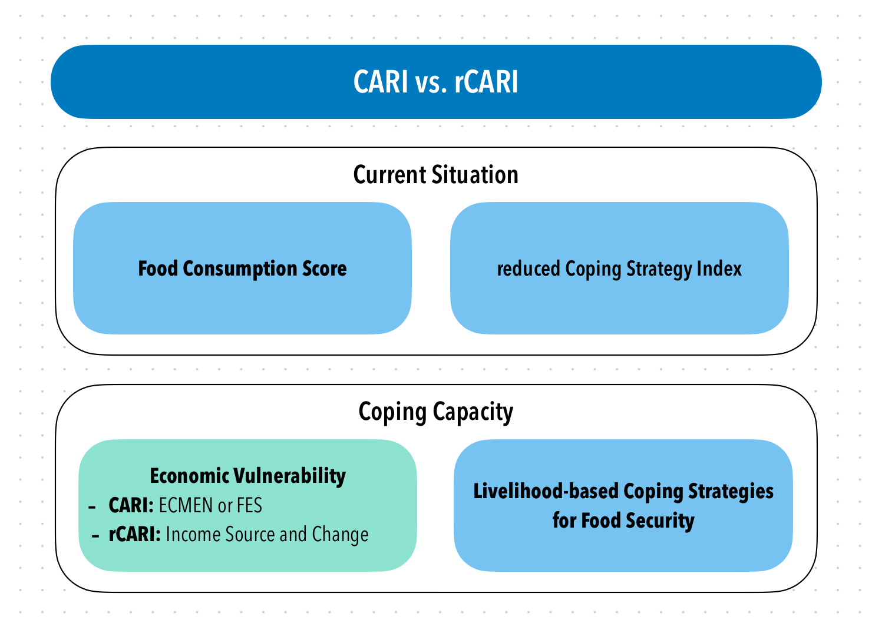
Background
CARI and rCARI aggregate indicators in a similar way and the only difference is in the Economic Vulnerability
To date, rCARI is not validated against the conventional CARI
Notes:
rCARI useful in emergencies where F2F survey is not feasible
The Challenge with rCARI numbers & methodology is that not it is been validated against CARI or IPC
Though is easily available, results are not globally accepted
rCARI is based on the following modules
Food consumption score
Consumption-based coping strategy (rCSI)
Livelihood coping strategy (usually a shorter version of the original)
Income sources
Changes in income

Slide 4
Main Research Objective
Validate and calibrate rCARI with the standard CARI methodology
Specific objectives:
Compare the results produced by CARI and rCARI methodologies from a statically identical groups within the same sample
Study the validity of phone survey modality to collect CARI indicators (FCS, rCSI, LCS, FES, and income sources)

Slide 5
RCT Design
1200 Sampled Households
(+ ~20% for non-response)
Randomized Assignment 1
Remote
F2F
300 HH Long-modules
300 HH Long-modules
Randomized Assignment 2
300 HH Short Modules
300 HH Short Modules

Slide 6
Myanmar Results

Slide 7
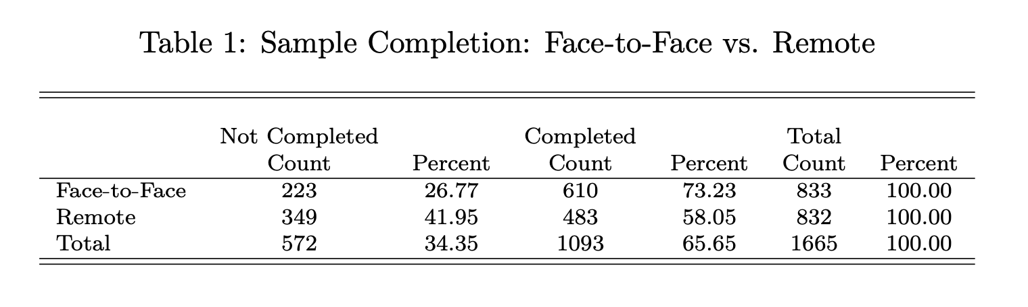
Sample Completion

Slide 8
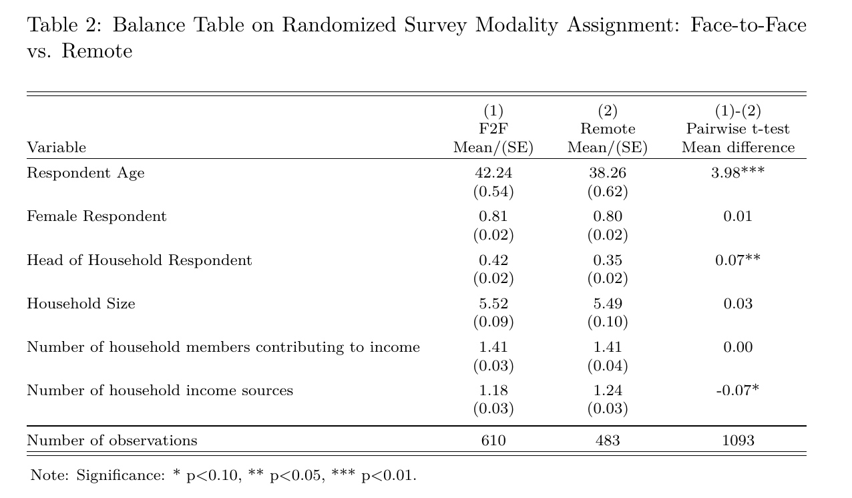
Balance Tests for Randomization

Slide 9
CARI vs. rCARI Disaggregation
Food security category | FES |  | Income | F2F | Pairwise t-test
 | (1) CARI Mean/(SE) | (2) rCARI Mean/(SE) | (3) rCARI Mean/(SE) | (4) rCARI Mean/(SE) | (5) (1) - (2) Mean diff. | (6) (1) - (3) Mean diff. | (7) (1)- (4) Mean diff.
Food Secure | 0.08 (0.01) | 0.04 (0.01) | 0.07 (0.01) | 0.16 (0.01) | 0.04*** | 0.02 | -0.08***
Marginally Food Secure | 0.44 (0.02) | 0.37 (0.02) | 0.40 (0.02) | 0.43 (0.02) | 0.08*** | 0.05 | 0.01
Moderately Food Insecure | 0.44 (0.02) | 0.54 (0.02) | 0.50 (0.02) | 0.39 (0.02) | -0.10*** | -0.06* | -0.05***
Severely Food Insecure | 0.03 (0.01) | 0.05 (0.01) | 0.04 (0.01) | 0.02 (0.01) | -0.02*** | -0.01 | 0.01
Vulnerable Households (M + S - FI) | 0.47 (0.02) | 0.59 (0.02) | 0.54 (0.02) | 0.41 (0.02) | -0.12*** | -0.07** | 0.06***
N | 610 | 483 | 483 | 610 | 1093 | 1093 | 610

Slide 10
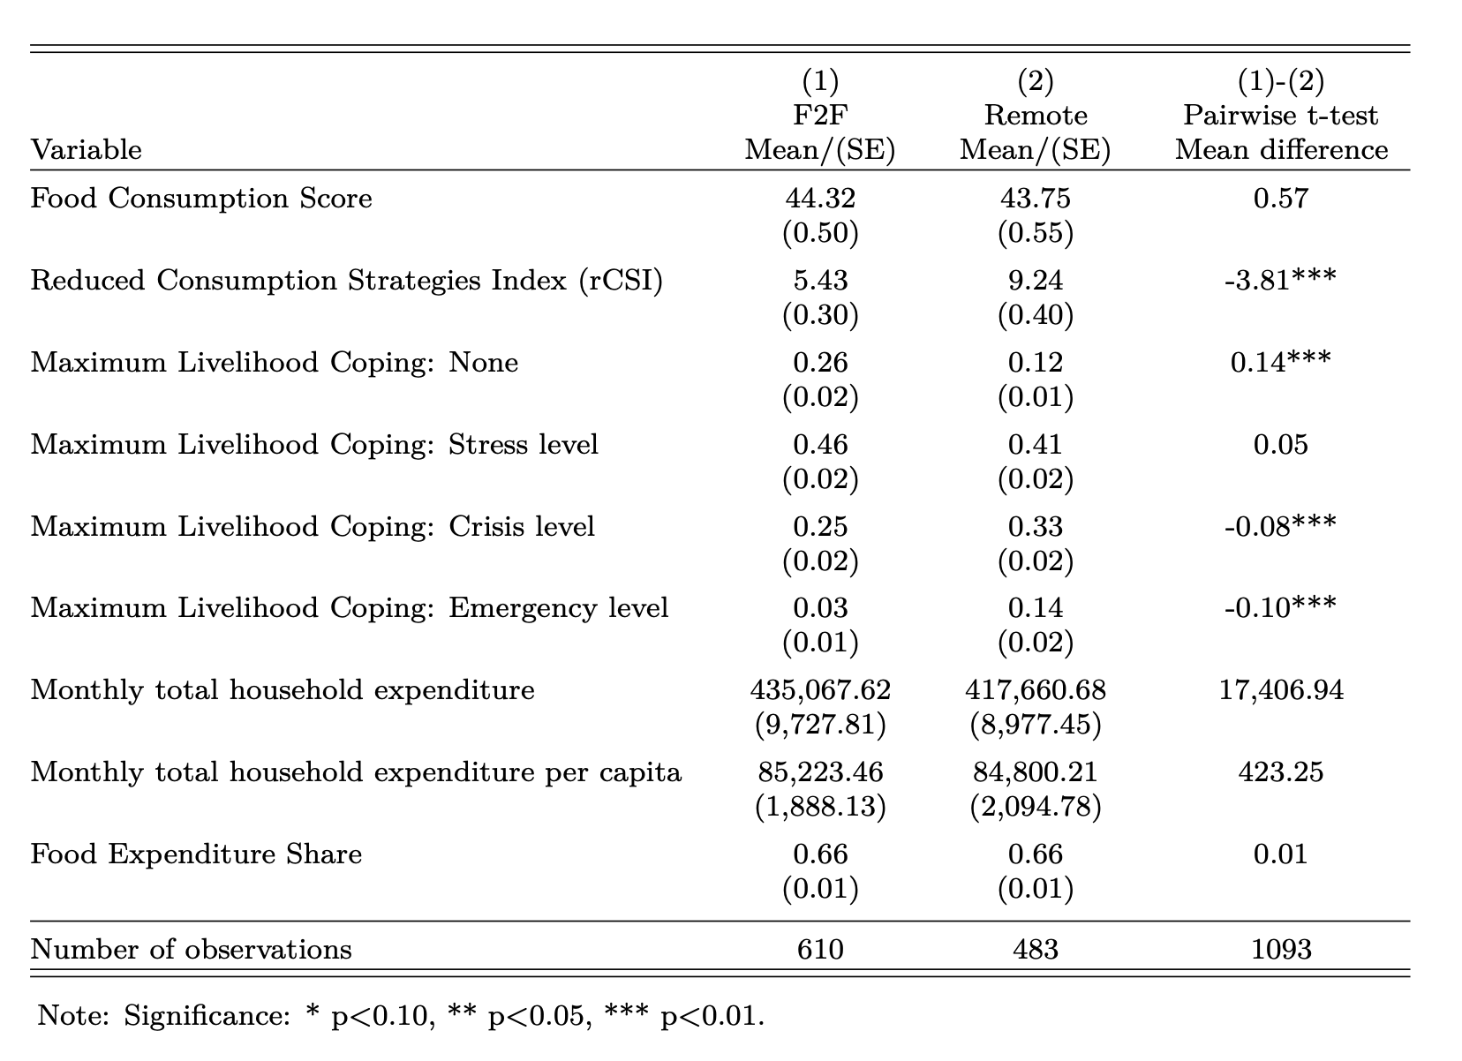
Other Food Security Outcome Indicators

Slide 11
FCS Indicator disaggregated over the Last 7days | (1) F2F Mean/(SE) | (2) Remote Mean/(SE) | (1)-(2) Pairwise t-test Mean difference
Cereals and Tubers | 7.00 (0.00) | 7.00 (0.00) | -0.00
Pulses | 1.63 (0.06) | 1.82 (0.07) | -0.20**
Dairy products | 0.17 (0.03) | 0.18 (0.03) | -0.01
Protein rich foods | 3.22 (0.08) | 3.01 (0.09) | 0.21
Vegetables | 6.42 (0.06) | 6.48 (0.06) | -0.06
Fruits | 1.73 (0.08) | 1.43 (0.08) | 0.30***
Oils | 6.67 (0.05) | 6.37 (0.06) | 0.30***
Sugar | 0.82 (0.06) | 0.85 (0.07) | -0.03
N | 610 | 483 | 1093

Slide 12
LCS-Strategy | (1) F2F Mean/(SE) | (2) Remote Mean/(SE) | (1)-(2) Pairwise t-test Mean difference
Lcs_stress_DomAsset_yn | 0.19 | 0.38 | -0.20***
 | (0.01) | (0.03)
Lcs_stress_HealthEdu_yn | 0.19 | 0.42 | -0.22***
 | (0.01) | (0.03)
Lcs_stress_Saving_yn | 0.30 | 0.42 | -0.12***
 | (0.01) | (0.03)
Lcs_stress_BorrowCash_yn | 0.36 | 0.45 | -0.09***
 | (0.02) | (0.03)
Lcs_crisis_ProdAssets_yn | 0.04 | 0.18 | -0.14***
 | (0.01) | (0.02)
Lcs_crisis_DomMigration_yn | 0.09 | 0.18 | -0.09***
 | (0.01) | (0.02)
Lcs_crisis_OutSchool_yn | 0.03 | 0.07 | -0.04***
 | (0.01) | (0.02)
Lcs_em_ResAsset_yn | 0.02 | 0.17 | -0.15***
 | (0.00) | (0.02)
Lcs_em_Begged_yn | 0.02 | 0.07 | -0.05***
 | (0.00) | (0.02)
Lcs_em_IllegalAct_yn | 0.01 | 0.04 | -0.03***
 | (0.00) | (0.01)
N | 610 | 483 | 1093

Slide 13
FCG by modality
FCG | (1) F2F Mean/(SE) | (2) Remote Mean/(SE) | (1)-(2) Pairwise t-test Mean difference
Acceptable | 0.54 (0.02) | 0.48 (0.02) | 0.06*
Borderline | 0.40 (0.02) | 0.45 (0.02) | -0.05*
Poor | 0.06 (0.01) | 0.07 (0.01) | -0.00
N | 610 | 483 | 1093

Slide 14
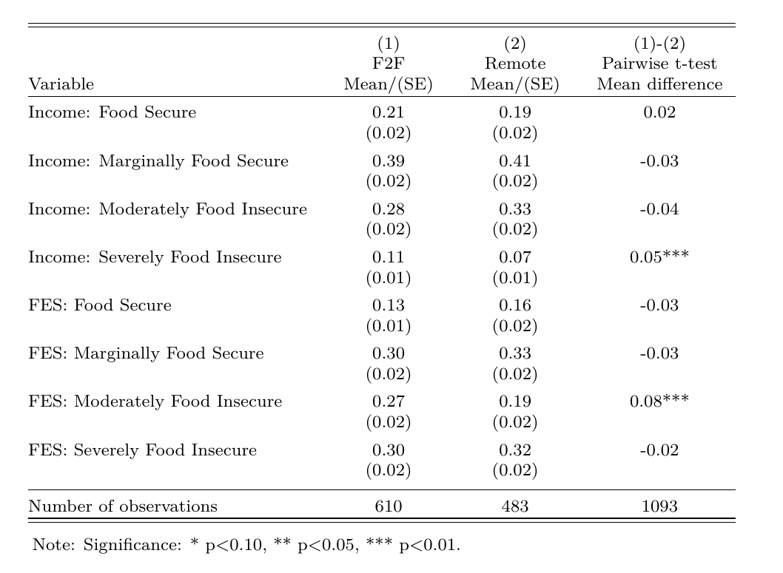
Income Sources vs. FES

Slide 15
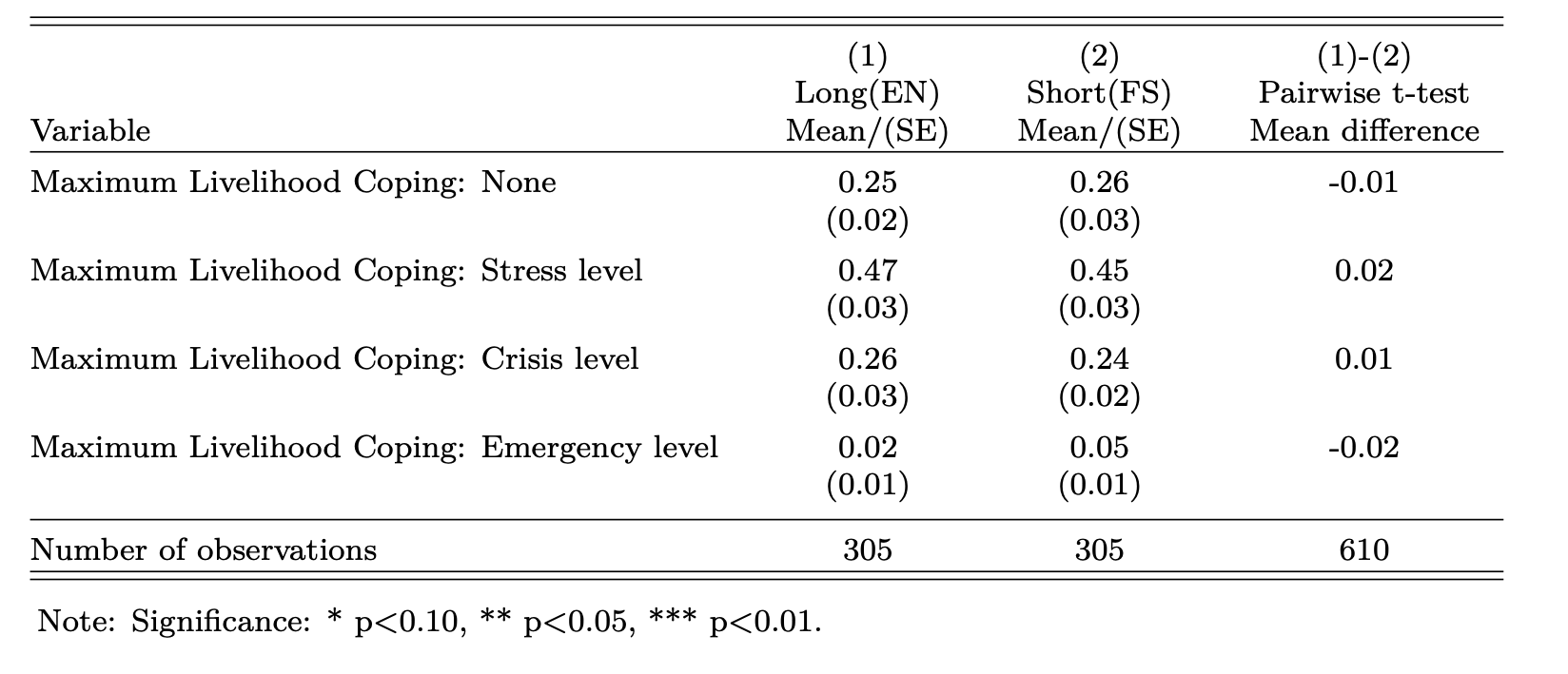
LCS-FS and LCS-EN from the F2F sample

Slide 16
Ecuador Results

Slide 17
Sample Completion
Modality | Not Completed Count | Percent | Completed Count | Percent | Total Count | Percent
Face2Face | 413 | 35 | 760 | 65 | 1,173 | 100
Remote | 543 | 45 | 656 | 55 | 1,199 | 100
Total | 952 | 40 | 1416 | 60 | 2,372 | 100

Slide 18
Balance Tests for Randomization
Variable | (1) F2F Mean/(SE) | (2) Remote Mean/(SE) | (1)-(2) Pairwise t-test Mean difference
Respondent Age
Female Respondent | 0.77 (0.02) | 0.76 (0.02) | 0.01
Head of Household Respondent | 0.60 (0.02) | 0.53 (0.02) | 0.07**
Household Size | 4.37 (0.08) | 4.57 (0.09) | -0.19
Number of household members contributing to income | 1.47 (0.03) | 1.45 (0.03) | 0.01
N | 760 | 656 | 1416

Slide 19
CARI vs. rCARI Disaggregation
Food security category | FES |  | Income | F2F | Pairwise t-test
 | (1) CARI Mean/(SE) | (2) rCARI Mean/(SE) | (3) rCARI Mean/(SE) | (4) rCARI Mean/(SE) | (5) (1) - (2) Mean diff. | (6) (1) - (3) Mean diff. | (7) (1)- (4) Mean diff.
Food Secure | 0.01 (0.00) | 0.00 (0.00) | 0.00 (0.00) | 0.03 (0.01) | 0.01** | 0.01* | -0.02**
Marginally Food Secure | 0.23 (0.02) | 0.07 (0.01) | 0.27 (0.02) | 0.33 (0.02) | 0.16*** | -0.03 | -0.10***
Moderately Food Insecure | 0.59 (0.02) | 0.69 (0.02) | 0.62 (0.02) | 0.53 (0.02) | -0.10*** | -0.03 | 0.06***
Severely Food Insecure | 0.16 (0.01) | 0.23 (0.02) | 0.11 (0.01) | 0.11 (0.01) | -0.07*** | 0.06*** | 0.06**
Vulnerable Households (M + S - FI) | 0.76 (0.02) | 0.92 (0.01) | 0.73 (0.02) | 0.64 (0.02) | -0.17*** | 0.03 | 0.12***
N | 760 | 656 | 656 | 760 | 1416 | 1416 | 760

Slide 20
Other Food Security Outcome Indicators
Indicator | (1) F2F Mean/(SE) | (2) Remote Mean/(SE) | (1)-(2) Pairwise t-test Mean difference
Food Consumption Score-FCS | 46.28 (0.78) | 52.54 (0.94) | -6.25***
Reduced Coping Strategies Index-rCSI | 19.86 (0.45) | 18.50 (0.46) | 1.36**
Livelihood coping: None | 0.09 (0.01) | 0.02 (0.01) | 0.07***
Livelihood coping: Stress level | 0.28 (0.02) | 0.08 (0.01) | 0.20***
Livelihood coping: Crisis level | 0.42 (0.02) | 0.19 0.02 | 0.23***
Livelihood coping: Emergency level | 0.21 (0.01) | 0.70 (0.02) | -0.50***
Food Expenditure Share: FES | 0.71 (0.01) | 0.79 (0.01) | -0.08***
N | 760 | 656 | 1416

Slide 21
Disaggregated FC by modality
FCS Indicator disaggregated over the Last 7days | (1) F2F Mean/(SE) | (2) Remote Mean/(SE) | (1)-(2) Pairwise t-test Mean difference
Cereals and Tubers | 7.00 (0.00) | 7.00 (0.00) | -0.00
Pulses | 1.63 (0.06) | 1.82 (0.07) | -0.20**
Dairy products | 0.17 (0.03) | 0.18 (0.03) | -0.01
Protein rich foods | 3.22 (0.08) | 3.01 (0.09) | 0.21
Vegetables | 6.42 (0.06) | 6.48 (0.06) | -0.06
Fruits | 1.73 (0.08) | 1.43 (0.08) | 0.30***
Oils | 6.67 (0.05) | 6.37 (0.06) | 0.30***
Sugar | 0.82 (0.06) | 0.85 (0.07) | -0.03
N | 610 | 483 | 1093

Slide 22
FCG by modality
FCG | (1) F2F Mean/(SE) | (2) Remote Mean/(SE) | (1)-(2) Pairwise t-test Mean difference
Acceptable | 0.54 (0.02) | 0.62 (0.02) | -0.09***
Borderline | 0.24 (0.02) | 0.22 (0.02) | 0.02
Poor | 0.22 (0.02) | 0.16 (0.01) | 0.07***
N | 760 | 656 | 1416

Slide 23
FCG + rCSI by modality
FCG | (1) F2F Mean/(SE) | (2) Remote Mean/(SE) | (1)-(2) Pairwise t-test Mean difference
Acceptable | 0.06 (0.01) | 0.04 (0.01) | 0.02
Acceptable with reduced coping | 0.48 (0.02) | 0.58 (0.02) | -0.10***
Borderline | 0.24 (0.02) | 0.22 (0.02) | 0.02
Poor | 0.22 (0.02) | 0.16 (0.01) | 0.07***
N | 760 | 656 | 1416

Slide 24
Income Sources vs. FES
Indicator | (1) F2F Mean/(SE) | (2) Remote Mean/(SE) | (1)-(2) Pairwise t-test Mean difference
Income
Regular and unchanged/increasing | 0.19 (0.01) | 0.25 (0.02) | -0.06***
Regular and reduced or irregular and Unchanged/increasing | 0.38 (0.02) | 0.41 (0.02) | -0.03
Irregular and reduced | 0.26 (0.02) | 0.24 (0.02) | 0.01
No income sources | 0.17 (0.01) | 0.09 (0.01) | 0.08***
FES
< 50% of HH Expenditure | 0.15 (0.01) | 0.05 (0.01) | 0.10***
50 – 65% of HH Expenditure | 0.17 (0.01) | 0.09 (0.01) | 0.08***
65 – 75% of HH Expenditure | 0.19 (0.01) | 0.18 (0.01) | 0.01
>= 75% of HH Expenditure | 0.49 (0.02) | 0.68 (0.02) | -0.19***
N | 760 | 656 | 1416

Slide 25
LCS-FS and LCS-EN from the F2F sample

Slide 27
CAR Results

Slide 28
Thank you

